Slide 1
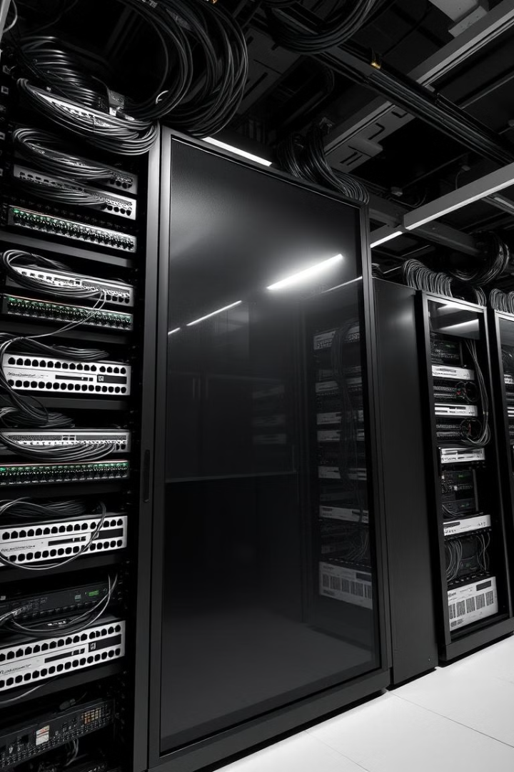
Identification of Network Components
This presentation will provide an overview of the key hardware components that make up a computer network, from network interface cards to routers and wireless access points. Understanding these fundamental elements is crucial for maintaining and troubleshooting network connectivity.

Slide 2
Network Components Overview
A comprehensive guide to understanding network hardware and infrastructure
Getting Started
1
Network component identification fundamentals
Basic network hardware concepts
2
Core Components
Network Interface Cards (NICs)
Routers and switches functionality
Connection Infrastructure
3
Wireless Access Points
Modems and gateways
Network cables and connectors
Network adapters and drivers
4
Mastering Networks
Troubleshooting techniques
Final review and key concepts

Slide 3
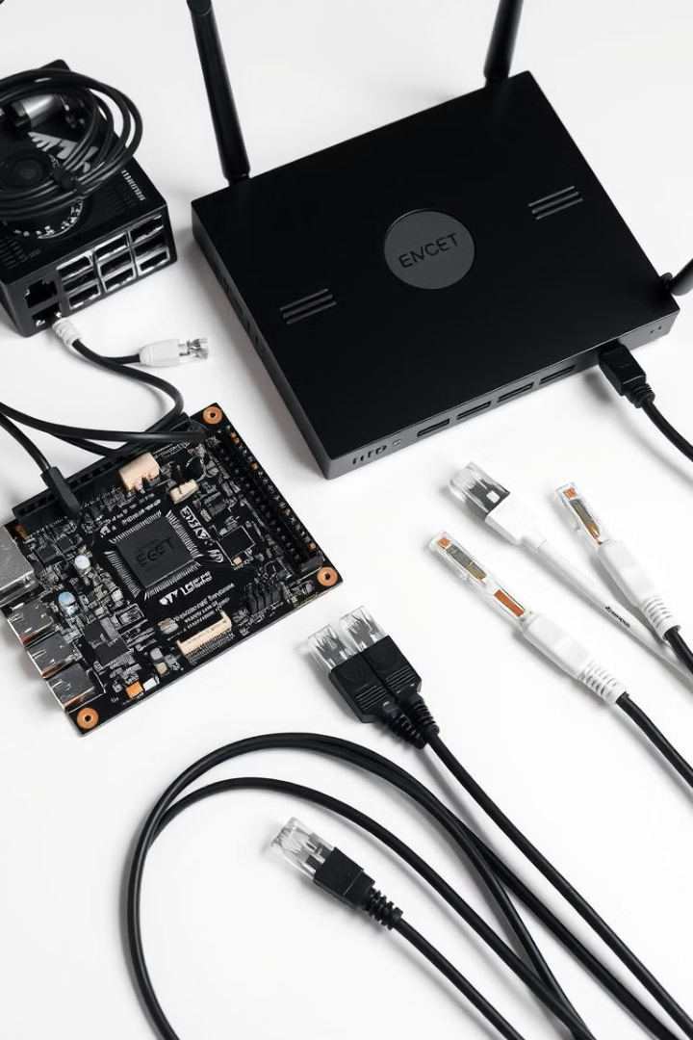
Introduction to Network Hardware
1
Network Essentials
2
Interconnectivity
Network hardware includes the physical devices that enable data communication between computers and other devices.
These components work together to transmit, receive, and route data across a local or wide area network.
3
Hands-on Learning
Identifying and understanding network hardware is a key skill for IT professionals and students.

Slide 4
Network Interface Cards (NICs)
Wired Connectivity
Wireless Capabilities
Driver Importance
NICs provide Ethernet ports for connecting devices to a local area network (LAN) using Ethernet cables.
Many NICs also include WiFi functionality, enabling wireless network connectivity without physical cables.
Proper NIC driver installation is crucial for ensuring stable and reliable network communication.

Slide 5
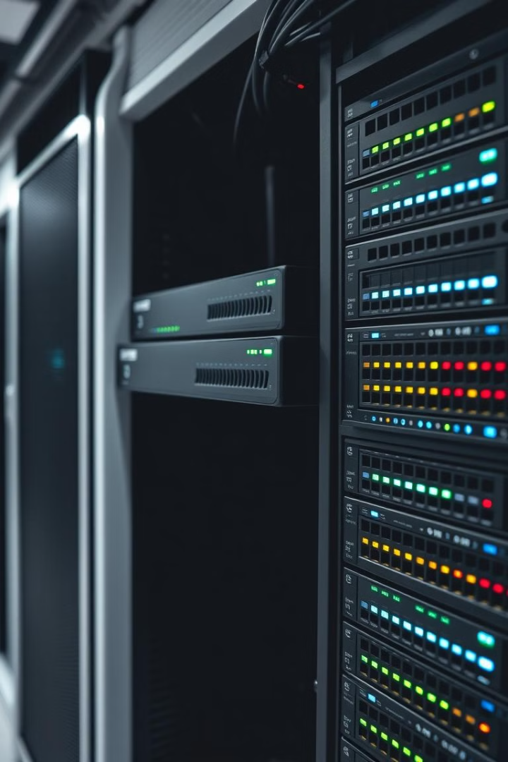
Routers and Switches
1
Routers
Routers interconnect networks, routing data between local and wide area networks.
2
Switches
Switches connect devices within a local network, facilitating high-speed data transfers.
3
Collaboration
Routers and switches work together to create a cohesive and efficient network infrastructure.

Slide 6

Wireless Access Points
Wireless Connectivity
Expanded Coverage
WAPs extend the reach of a network, providing wireless access in areas where wired connections are impractical.
Wireless access points (WAPs) enable wireless devices to connect to a network without physical cables.
Security Features
Scalability
WAPs often include built-in security protocols to protect wireless network traffic and access.
Multiple WAPs can be deployed to create a seamless wireless network that scales to meet growing needs.

Slide 7
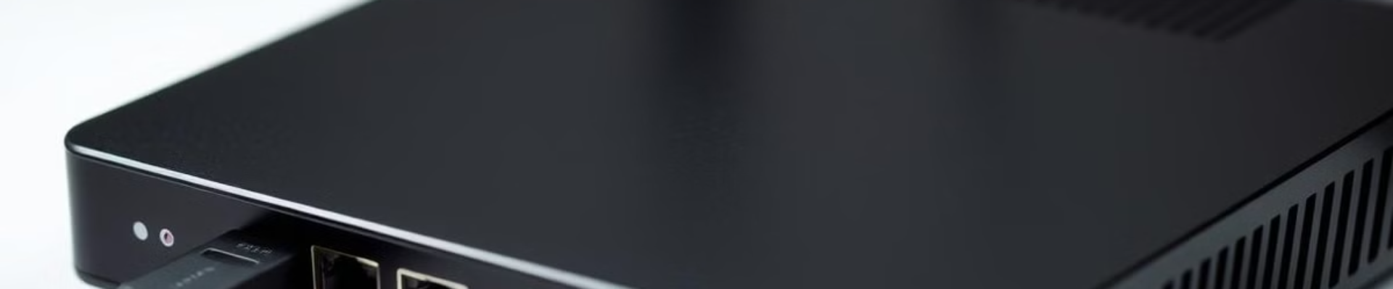


Modems and Gateways
Modems
Gateways
Connectivity
Modems convert digital data into analog signals for transmission over telephone or cable lines.
Gateways combine the functionality of a modem and a router, providing internet access and network connectivity.
Modems and gateways enable devices to connect to the internet and communicate across networks.

Slide 8
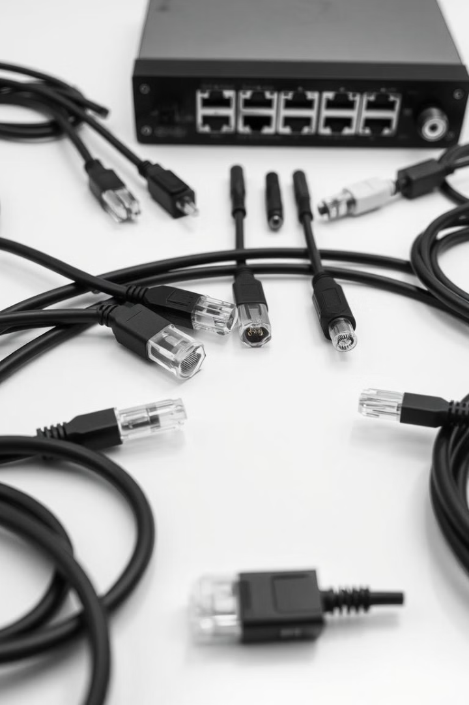



Network Cables and Connectors
Ethernet Cables
Ethernet cables, such as Cat5e and Cat6, provide wired connections between network devices.
Coaxial Cables
Coaxial cables are used for cable internet and television connections, as well as some legacy networks.
Connectors
Network cables utilize various connector types, such as RJ-45, BNC, and F-Type, to interface with devices.

Slide 9
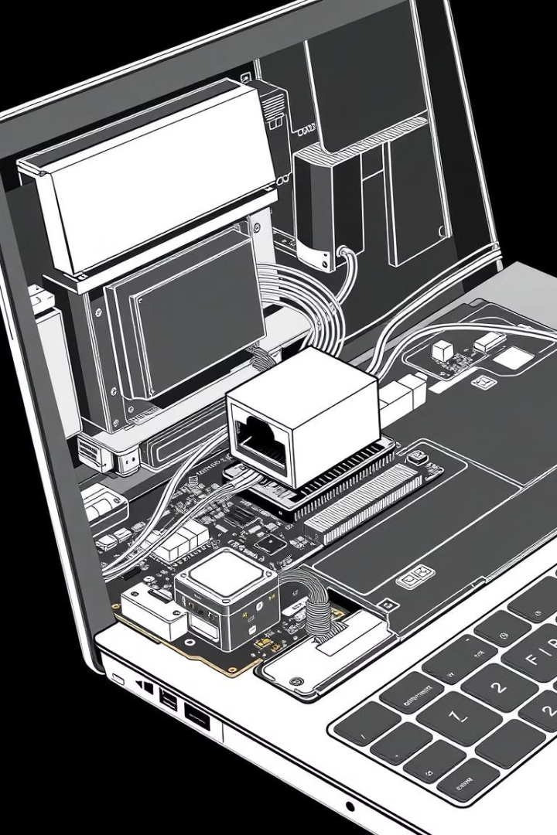
Network Adapters and Drivers
Network Adapters
Provide network connectivity for devices without built-in NICs, such as laptops and desktops.
Drivers
Ensure proper communication between the network adapter and the device's operating system.
Compatibility
Selecting the correct driver is crucial for ensuring reliable and efficient network performance.

Slide 10

Troubleshooting Network Issues
1
Hardware Verification
2
Software Configuration
Checking the physical network components, such as cables, ports, and adapters, is a crucial first step.
Ensuring proper driver installation and network settings can resolve many connectivity problems.
3
Isolation and Testing
Isolating the issue and testing network components individually can help identify the root cause of the problem.

Slide 11
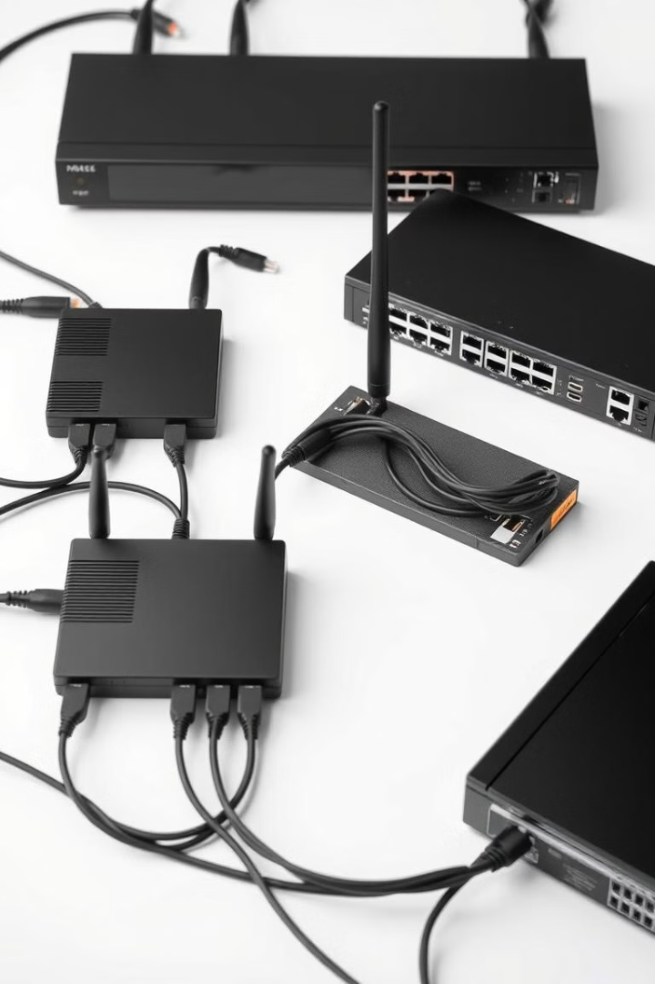
Conclusion and Key Takeaways
Network Fundamentals
Hands-on Experience
Understanding the core hardware components of a network is essential for maintaining, troubleshooting, and improving network performance.
Practical experience with network hardware and tools is crucial for developing the skills needed in the IT field.
Continuous Learning
Importance of Networks
As technology evolves, staying up-to-date with the latest network hardware and best practices is key.
Reliable and efficient networks are the backbone of modern communication and data exchange in both personal and professional settings.

Slide 12

Thank You for Your Participation
We sincerely thank all attendees and faculty members for your valuable time and engagement throughout this presentation.
Presented By AIML-C (Roll No. 16, 17, 18 ,19)

